Slide 1
CMPE 321
Flip Flops and Registers

Slide 2
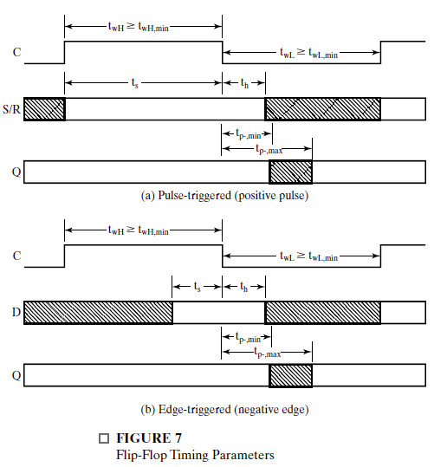
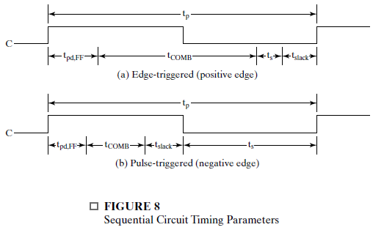
Flip Flop Timing
tp : the propagationn delay times.
ts: set up time.
th :hold time.
tw : the clock pulse width.
The pulse-triggered flipflops: ts = tw
The edge-triggered flipflops: ts < tw
The edge - triggered flip flops tend to be provide faster design.(D flipflops)

Slide 3
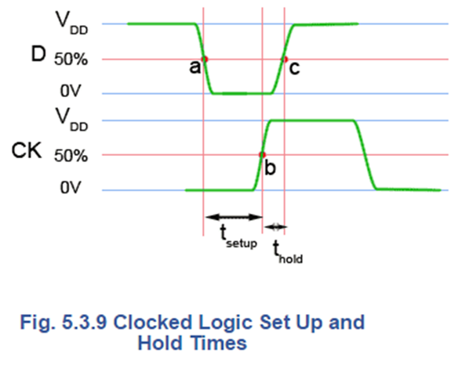
How Would It Behave? D Flip Flops
Positive edge D
Activehigh D lach?
Negative edge D
Active low D latch?
http://www.learnabout-electronics.org/Digital/dig53.php

Slide 4
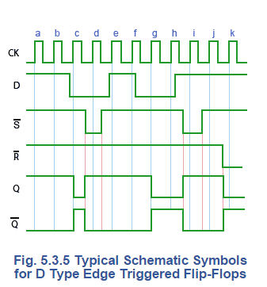
Edge-Triggered Flip Flops
At the positive going edges of clock pulses a and b, the D input is high so Q is also high.
Just before pulse c the D input goes low, so at the positive going edge of pulse c, Q goes low.
Between pulses c and d the asynchronous S input goes low and immediately sets Q high.
The flip-flop then ignores pulse d while S is low, but as S returns high, and D has also returned to its high state before pulse e, Q remains high during pulse e.

Slide 5
Edge-Triggered Flip Flops (Cont.)
At the positive going edge of pulse h, the low level of input D remains, keeping Q low, but between pulses h and i, the S input goes low, overriding any action of D and immediately making Q high.
D is still high at the positive going edge of pulse f, and because the flip-flop is positive edge triggered, the change in the logic level of D during pulse f is ignored until the positive going edge of pulse g, which resets Q to its low level.
Clock pulse i is again ignored, due to S being in its active low state and Q remains high, under the control of S until just before pulse j. At the positive going edge of pulse j, input D regains control, but as D is high and Q is already high, no change in output Q occurs.
Finally, just before pulse k, the asynchronous reset input (R) goes low and resets Q to its low level (logic 0), which again causes the D input to be ignored.
http://www.learnabout-electronics.org/Digital/dig53.php

Slide 6
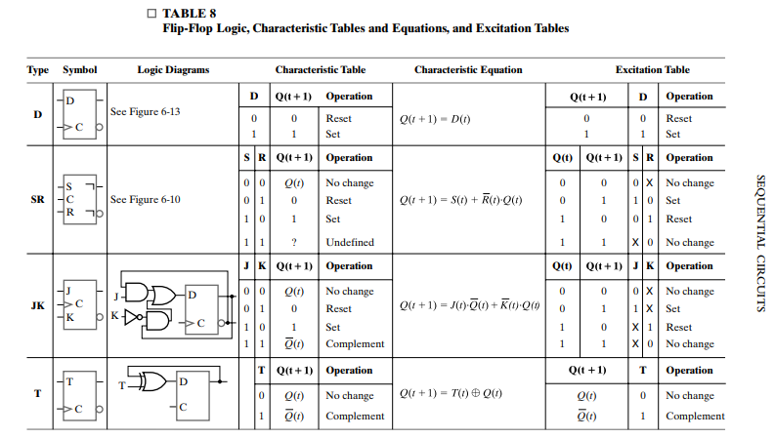
Flip-Flop Types

Slide 7
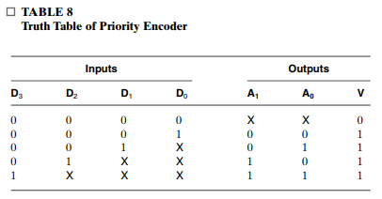
Priority Encoder
A priority encoder is a combinational circuit that implements a priority function.
The operation of the priority encoder is such that if two or more inputs are equal to 1 at the same time, the input having the highest priority takes precedence.

Slide 8
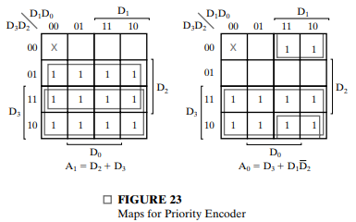


Slide 9
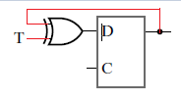
How to Convert Flip-Flops to Each Other
Convert D Flip-Flop to T Flip-Flop Add EX-OR

Slide 10
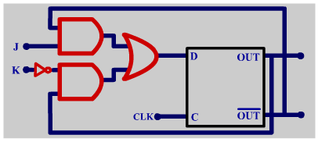
Convert D Flip-Flop to JK Flip-Flop
D flipflop + NOT+ AND+AND +OR = JK

Slide 11
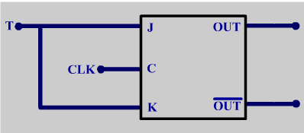
JK Flip-Flop +OTHER = T Flip-Flop

Slide 12
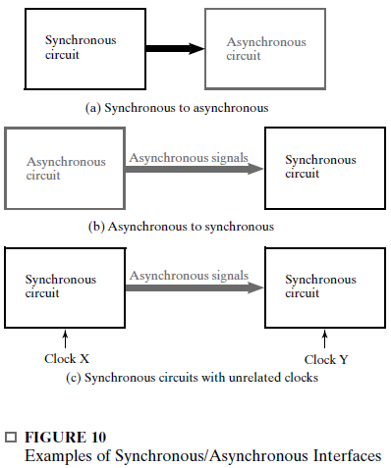
Asynchronious Interactions

Slide 13

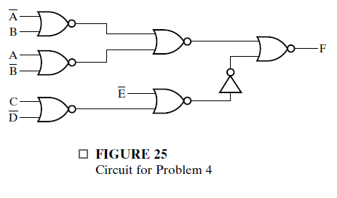
Question 1

Slide 14



Answer 1

Slide 15
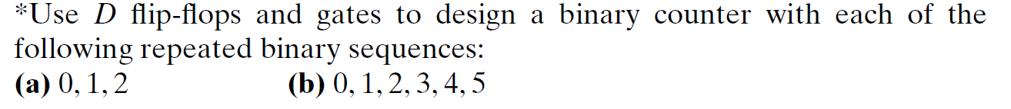
Question 2

Slide 16
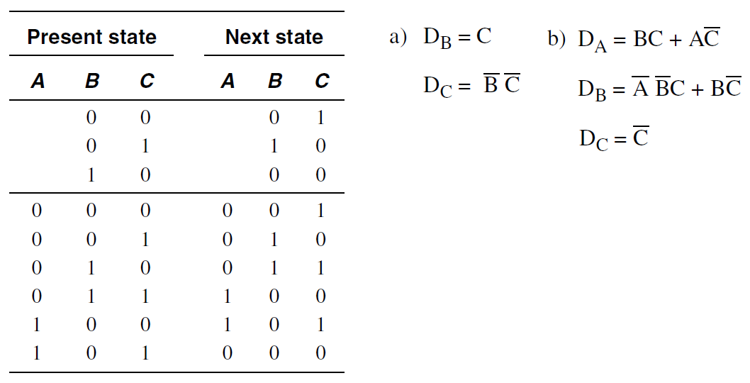
Answer 2

Slide 18
Chapter 4 and 5 Review
Half Adders, Full Adders, Adder- Substructors,

Slide 19
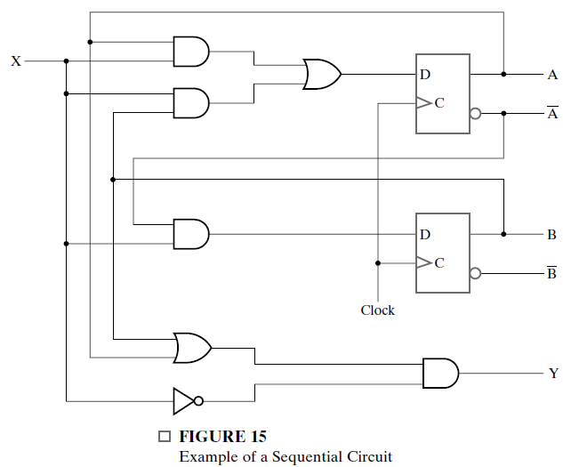
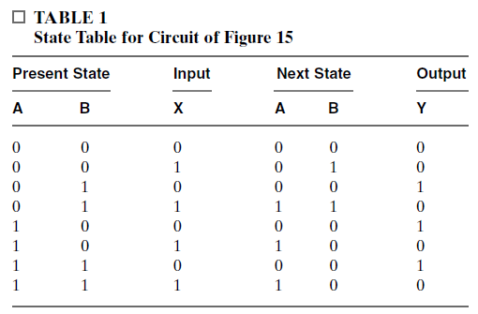
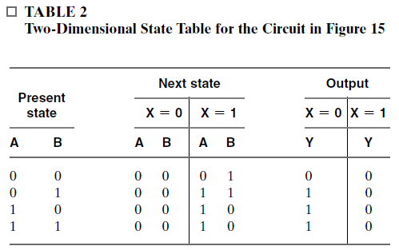
Example Sequential Circuit

Slide 20
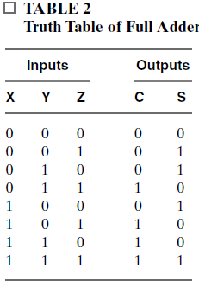
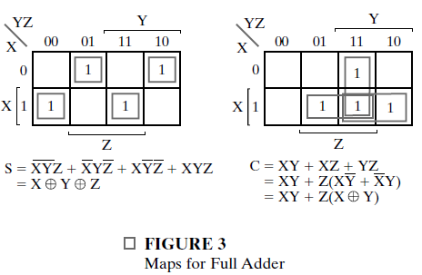
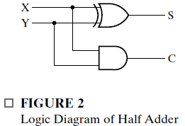
Half Adder – Full Adder

Slide 21
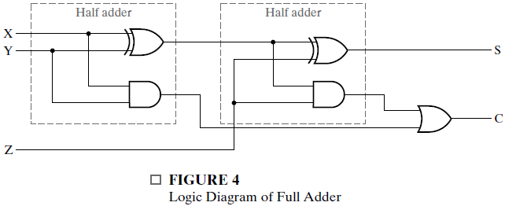
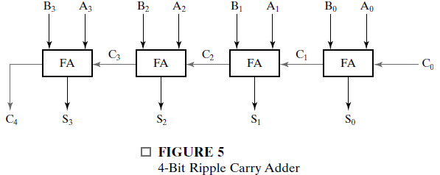
Half Adder to Full Adder
Full Adder to Ripple Carry Adder

Slide 22
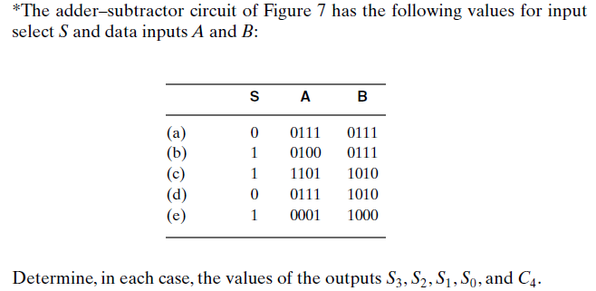
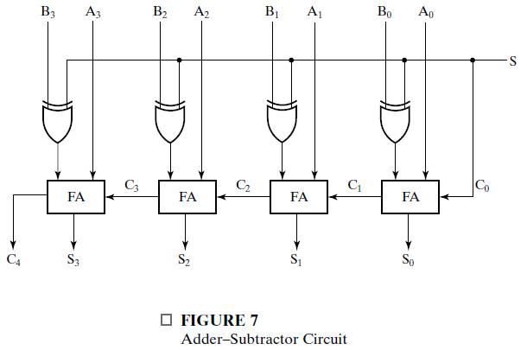
Question 4

Slide 23
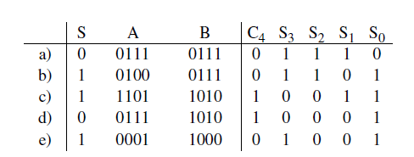
Answer 4

